Slide 1

Heat Transfer can occur in three ways:
Conduction
Convection
Radiation
Notes:
Instructional Approach(s): The teacher should present the information on the slide.

Slide 2
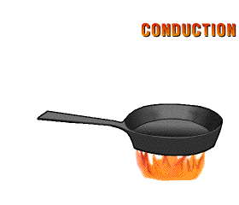
Conduction
Conduction is the transfer of heat by direct contact (particles collide)
Conduction occurs most easily in solids
and liquids

Slide 3
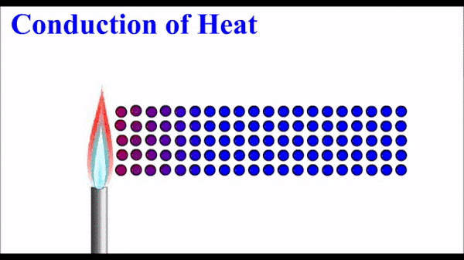
Conduction
Why is conduction easier in solids and liquids?
Atoms and molecules are closer together in solids and liquids. So, the particles need to move only a short distance before they bump into one another and transfer energy.

Slide 4
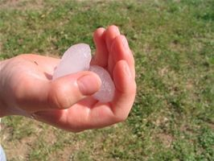
Explain the movement of thermal energy in the picture below.

Slide 5
Faster moving molecules in your warm hand bump against the slower moving molecules in the ice. Thermal energy moves from your warmer hand to the colder ice. The slow moving molecules in the ice move faster.

Slide 6
How is this an example of Conduction?
Faster moving molecules in your warm hand bump against the slower moving molecules in the ice to transfer thermal energy. Direct contact of the particles occurs; therefore, heat is transferred by Conduction.

Slide 7

Your turn…Explain the movement of thermal energy if you were about to eat the Chinese food below. How is this an example of Conduction?

